Slide 1
COMPUTER ORGANIZATION AND ARCHITECTURE
Dr. Rjzwan Khan
Department of Computer Science and Engineering
School of Computing
Galgotias University

Slide 2
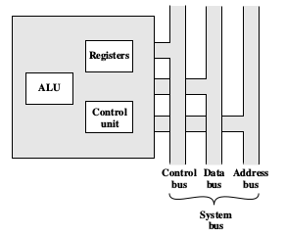
PROCESSOR ORGANIZATION
Figure below is a simplified view of a processor, indicating its connection to the rest of the system via the system bus.

Slide 3
The ALU does the actual computation or processing of data. The control unit controls the movement of data and instructions into and out of the processor and controls the operation of the ALU. In addition, the figure shows a minimal internal memory, consisting of a set of storage locations, called registers.

Slide 4
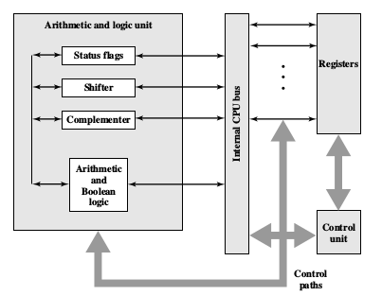
Figure below depicts is a slightly more detailed view of the processor.

Slide 5
The data transfer and logic control paths are indicated, including an element labeled internal processor bus. This element is needed to transfer data between the various registers and the ALU because the ALU in fact operates only on data in the internal processor memory. The figure also shows typical basic elements of the ALU. Note the similarity between the internal structure of the computer as a whole and the internal structure of the processor. In both cases, there is a small collection of major elements (computer: processor, I/O, memory; processor: control unit,ALU, registers) connected by data paths.

Slide 6
Basic Instruction Cycle
Start
Fetch the next
Instruction
Opcode Fetch Cycle
Decode
Instruction
Decode Cycle
Fetch
Cycle
No
If
Operand(s)
required
Yes
Fetch
Operand(s)
Operand Fetch Cycle
Execute
Instruction
Execute Cycle
Stop

Slide 7
Single Bus Organisation of a Processor
Control signals
. . . .
PC
Address Lines
Instruction
Decoder and
Control logic
MAR
Memory
Bus
MDR
Data Lines
Internal Processor Bus
Y
Constant
Value
IR
Select
MUX
R0
.
.
.
Add
A
B
ALU
Control
Lines
Sub
.
.
.
ALU
R(n-1)
XOR
Carry In
Z
TEMP

Slide 8


